Slide 1
Estonia
Elina Nikitina
Ivona Jakobson
Rodion Zubets
Daria Ivanova
Sakala Eragümnaasium

Slide 4
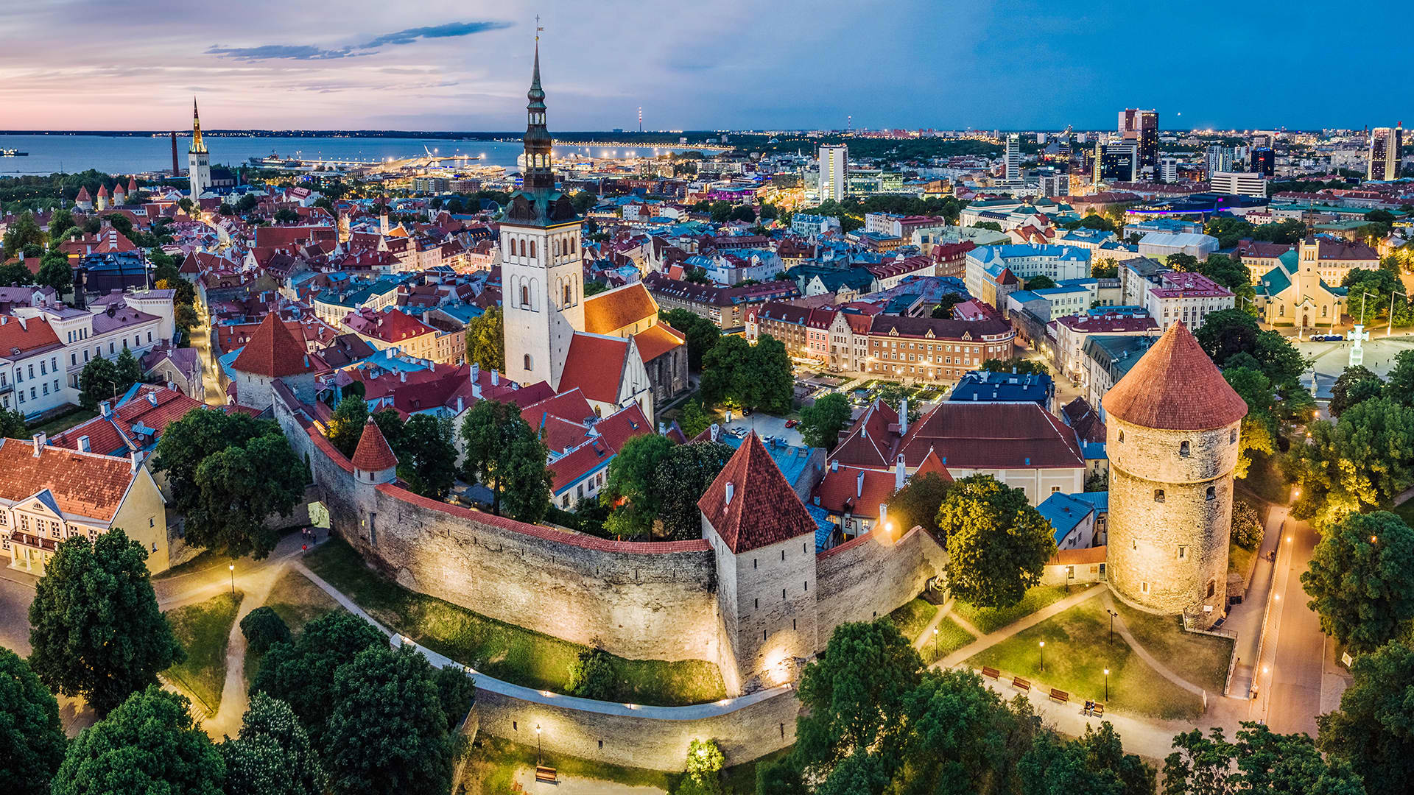
Old Town

Slide 5
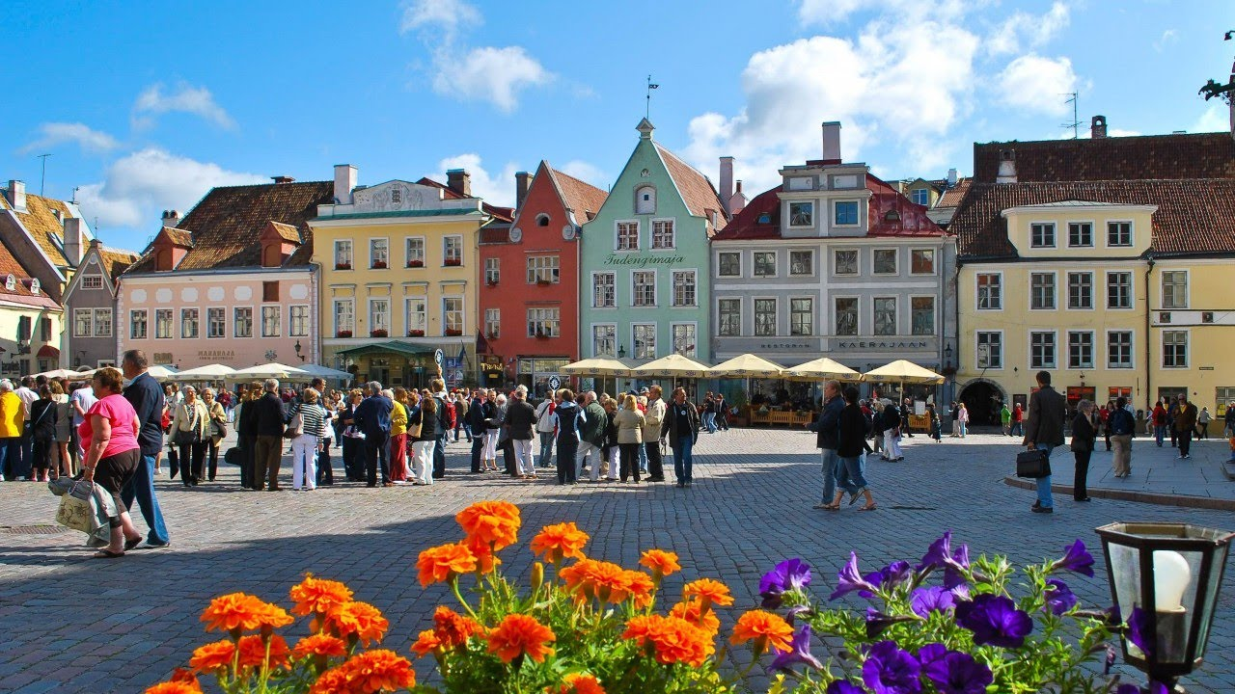
Beautiful buildings

Slide 6
Weather
Notes:
Although the weather in Estonia is often wet and rainy, we love to walk and spend time outdoors. You just need to have a pair of beautiful rubber boots and a raincoat.

Slide 7
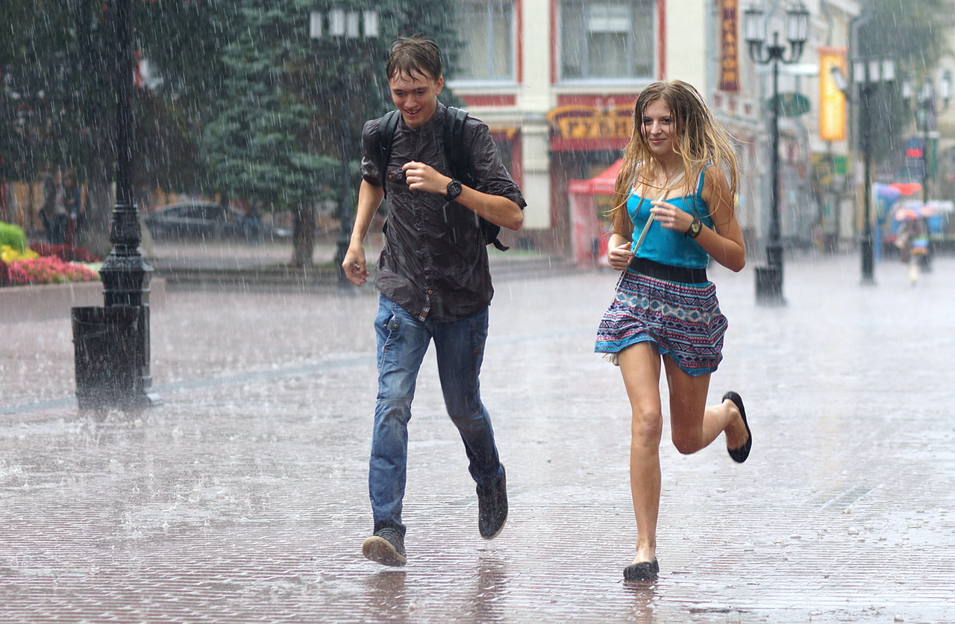
Running away from rain

Slide 8
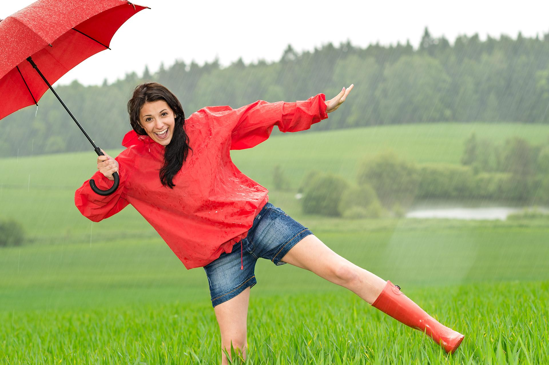
Fun in the rain

Slide 9
Port
Notes:
Estonia is a sea country
Tallinn has been a convenient port since the 10th century
Today the port serves cargo steamers and passenger liners
There are even some ports for private, small yachts

Slide 11
Swamps
swamps
Notes:
Estonian nature is rich in swamps
Bogs formed after melting glacier
Some swamps (for example, Viru swamp) are refined and made accessible to the public

Slide 12
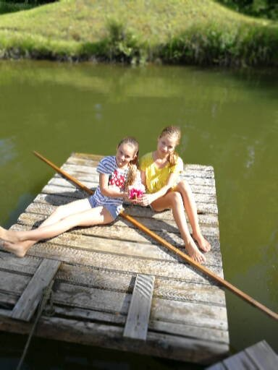
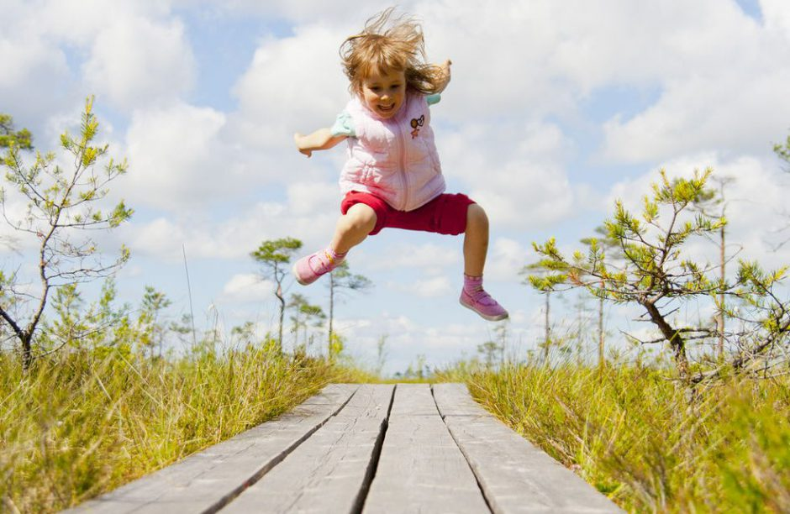
Spending a good time in a bog

Slide 13
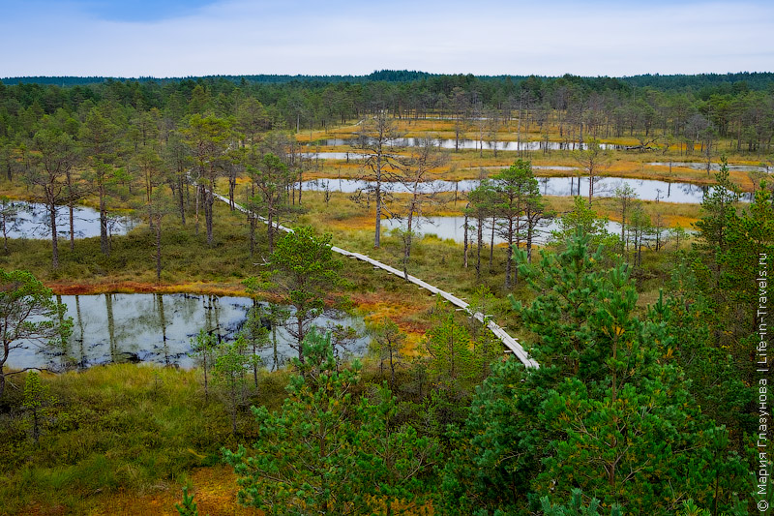
A beautiful view

Slide 14
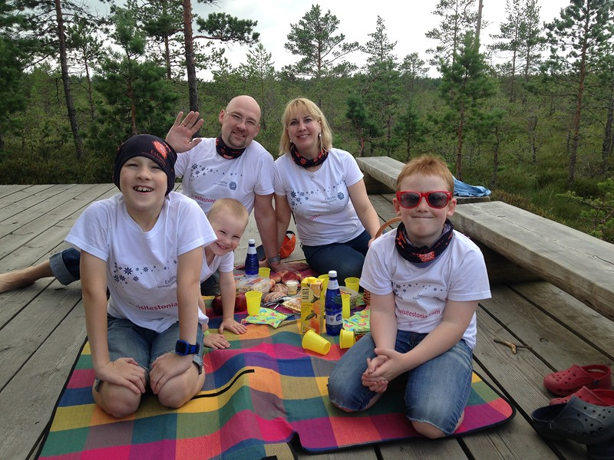
People make picnics

Slide 15
Song festivals
Notes:
Every 5 years almost 100 000 Estonians gather to celebrate Song Festival. The people wear special national clothes and sing national songs, dance and play games. This holiday is so special that the president of Estonia also puts on her best national clothes and take part in this festival. Frankly speaking, I’ve never taken part in this holiday but I would like to do it next time in 2019!

Slide 16
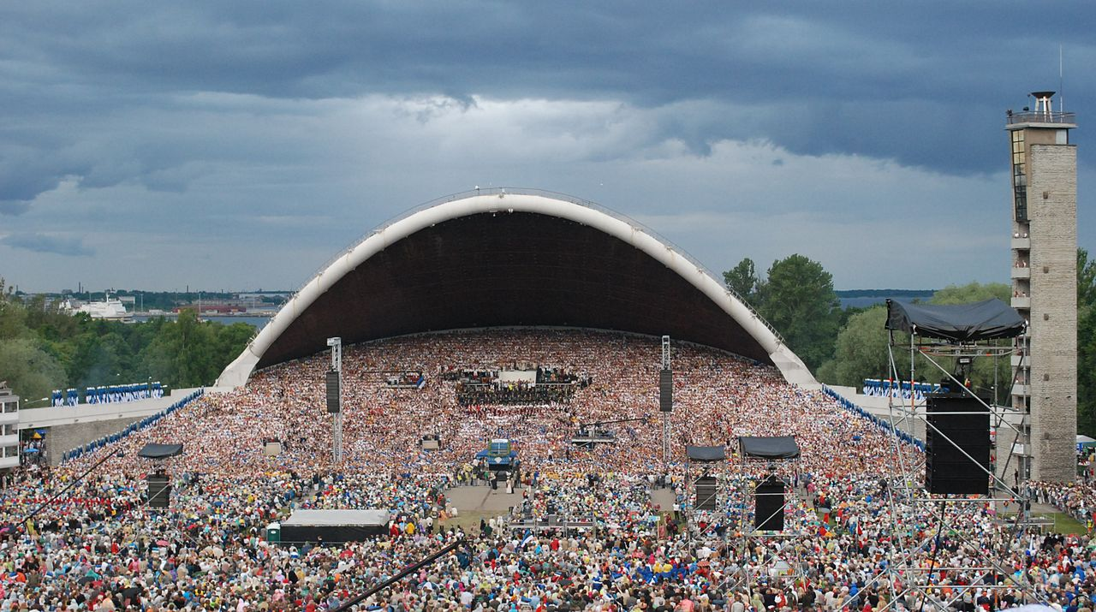
Festival place

Slide 17
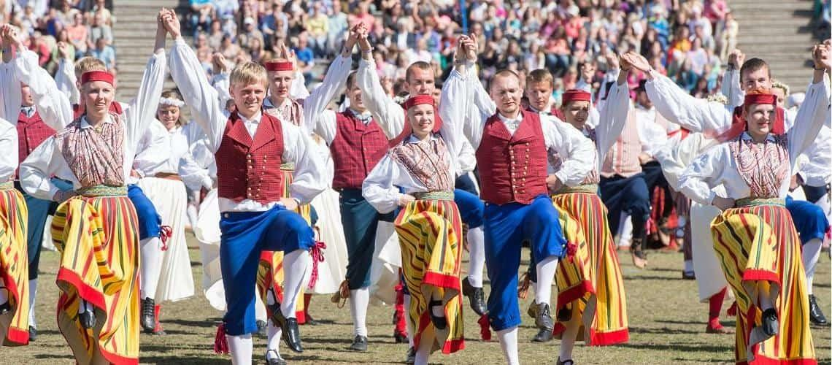
National clothes

Slide 18
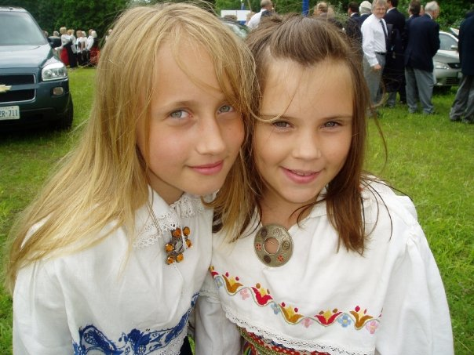

Slide 19
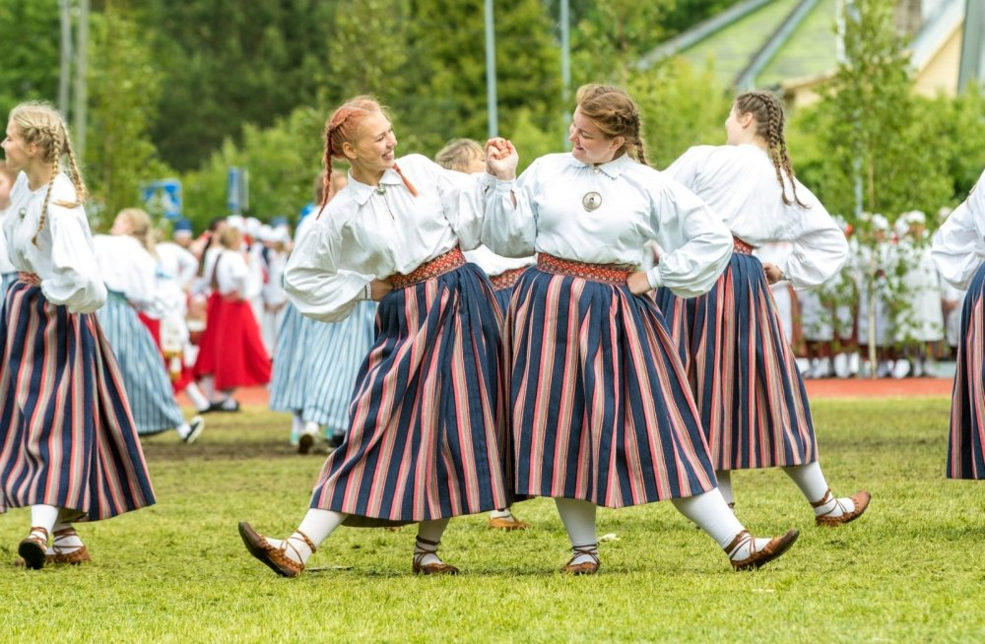
Estonian dance

Slide 20
Medieval traditions

Slide 21
Notes:
Estonia has a big amount of medieval traditions. One of them is Old Town days that begin in late spring and finish in the beginning of summer. All people dress up and wear medieval costumes, take part in crafts, games, plays, sing traditional songs and have fun

Slide 22
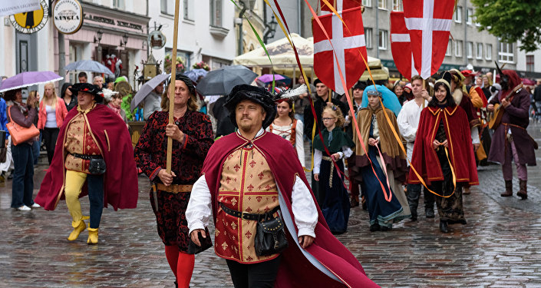

Slide 23
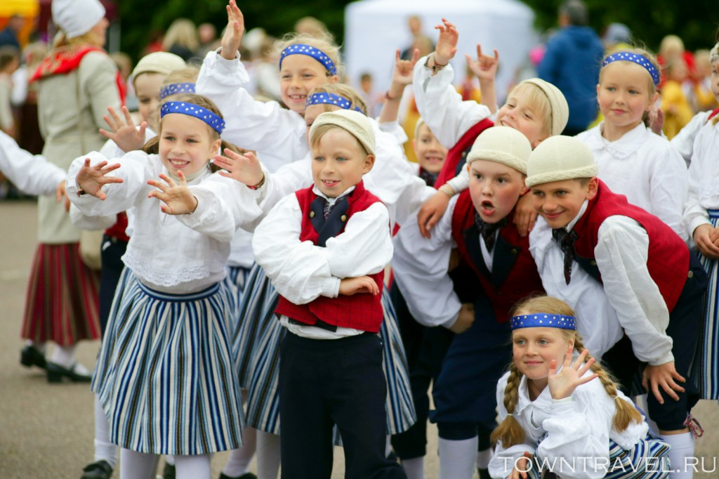

Slide 24
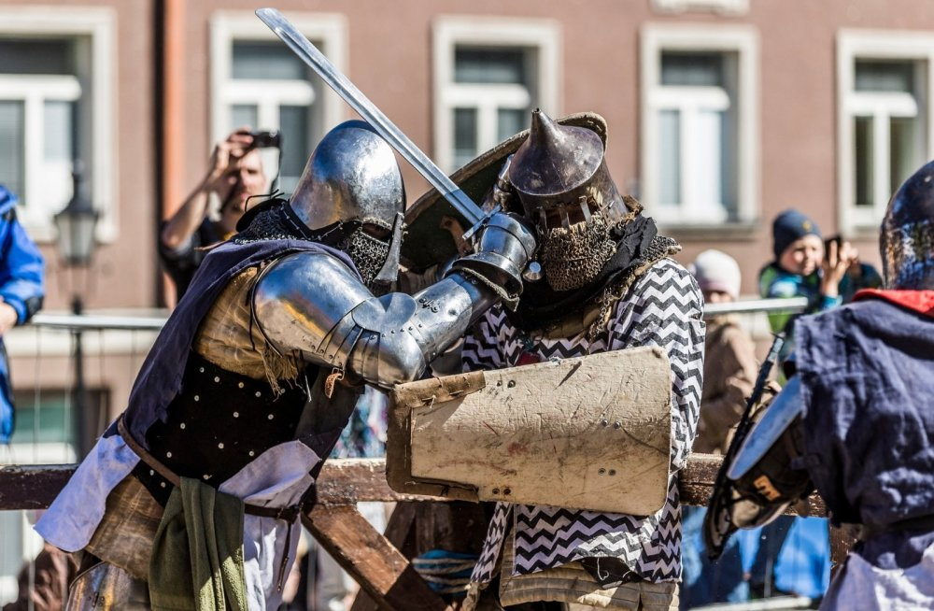
Knight Fight

Slide 25
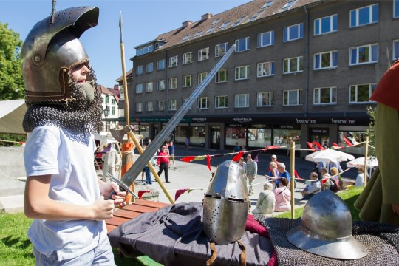

Slide 26
Christmas market
Notes:
Another medieval tradition in Estonia is a special Christmas market in the heart of Tallinn that is held every December before Christmas on Town Hall square.
I love that fair as I can buy hot spicy drinks, gingerbread, and other delicious food. We love Christmas fair as we can have so much fun skating at the Ice Rink while small children can enjoy a exciting ride on a Christmas train.

Slide 27
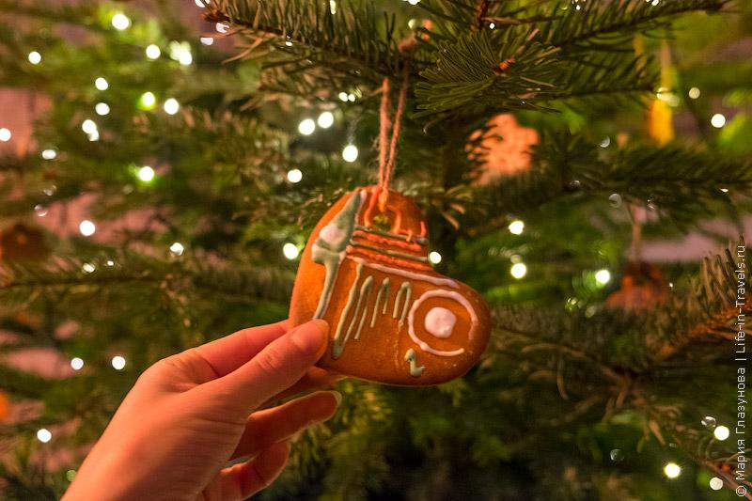

Slide 28
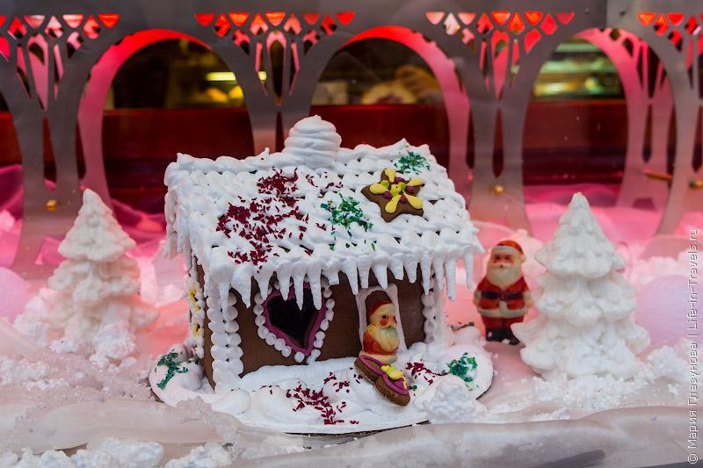

Slide 29
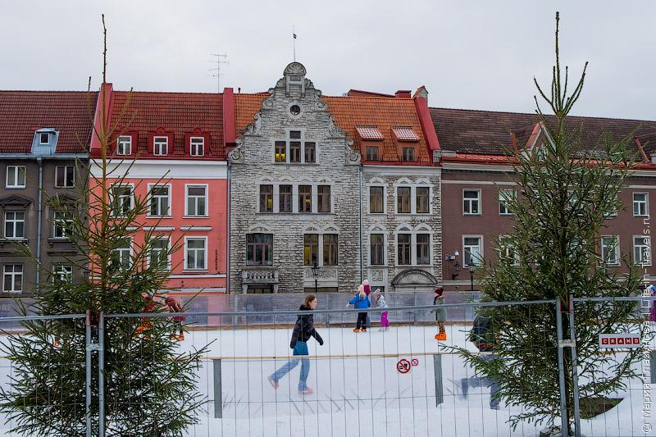

Slide 30
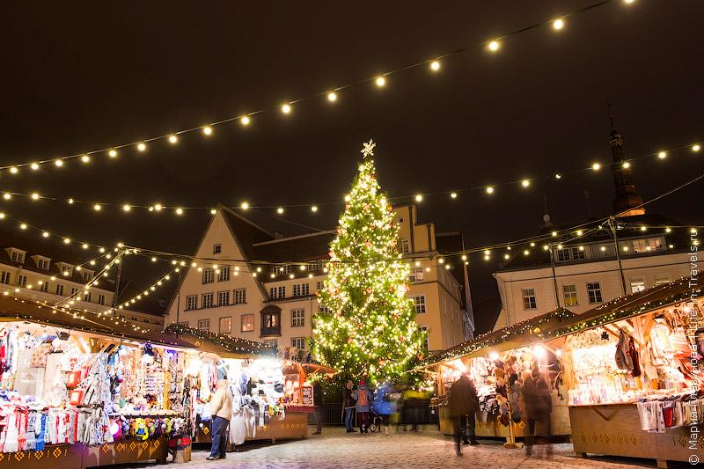

Slide 31
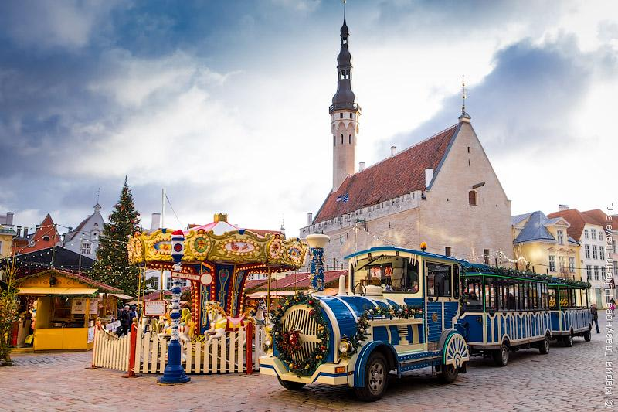

Slide 32
Innovations
Notes:
We are so proud of our country because many innovations have been made in Estonia. One of them is Skype. Every day thousands of people use Skype

Slide 33
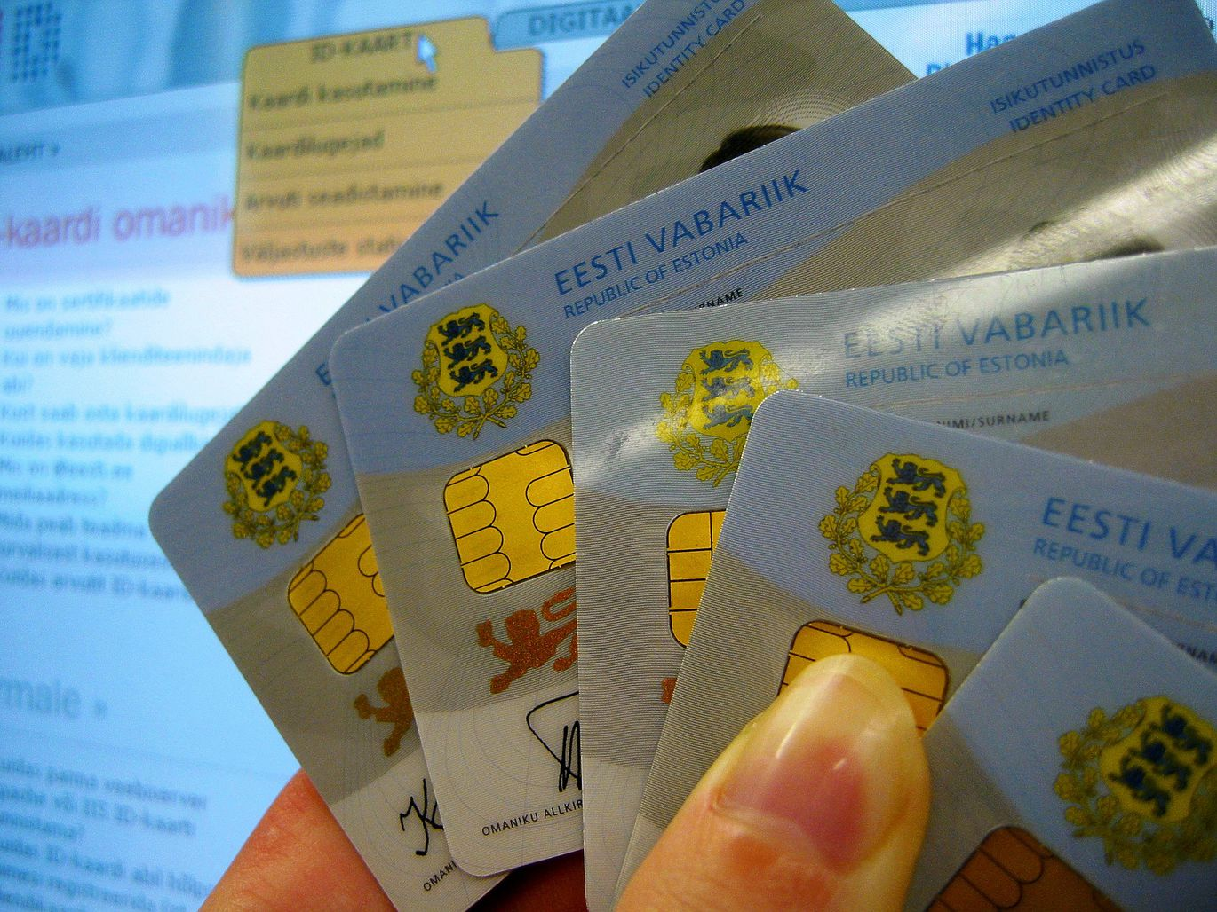
ID Card
Notes:
We are able to travel using an electronic passport that is really a small digital card
It is also a step towards a greener city because fewer people are using their personal cars.

Slide 34
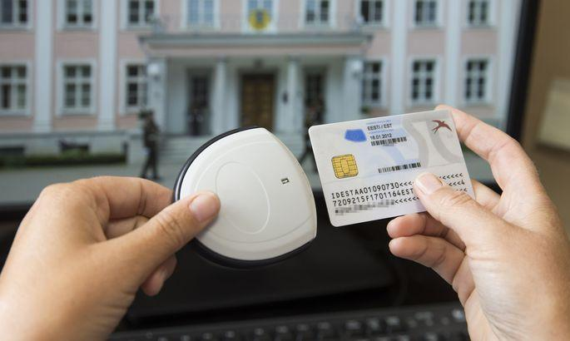

Slide 35
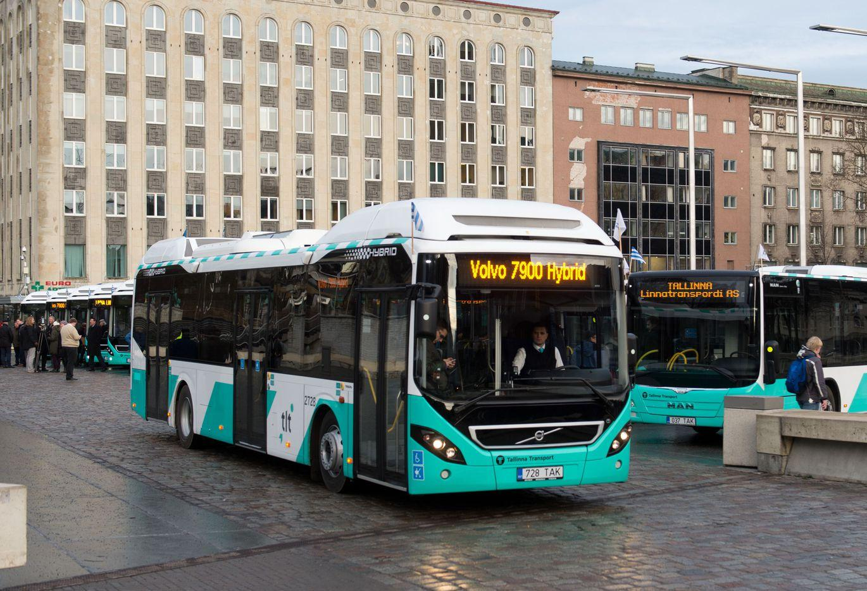
Innovations that made our life easier
Notes:
In 2013 Tallinn became the first city in the world to offer totally free public transport.

Slide 36
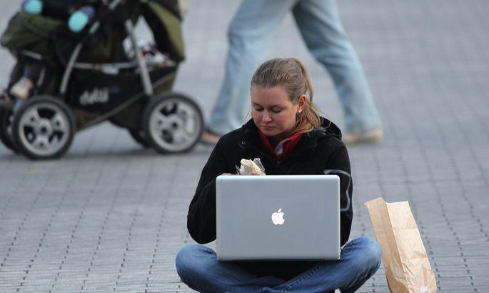
Internet connection
Notes:
We feel so lucky to have a high-speed Internet connection everywhere, even deep in the woods, believe me or not but we can connect to free Wi-Fi in most public places like schools, buses or trains, and even in parks and on beaches!

Slide 37
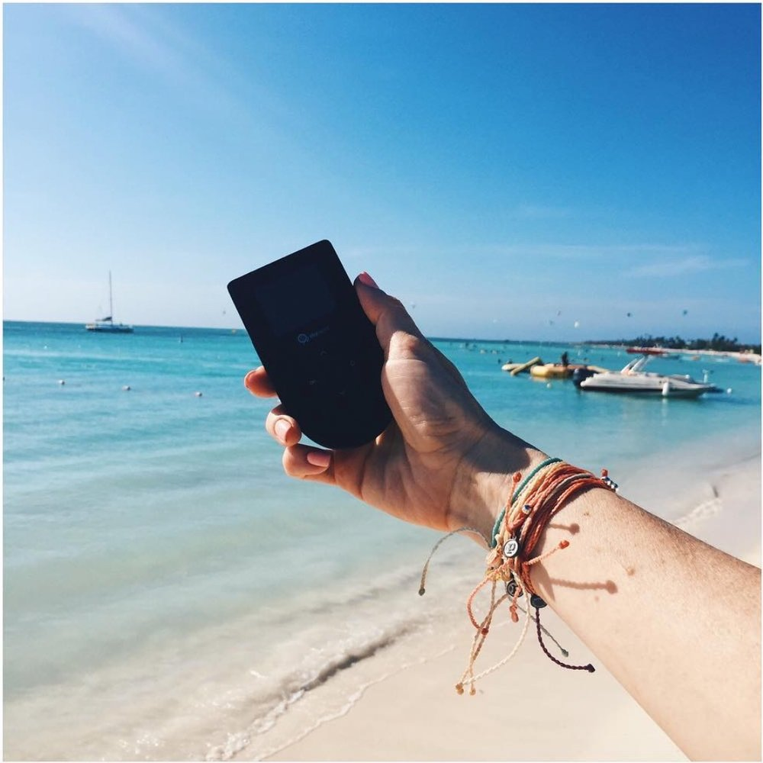

Slide 38
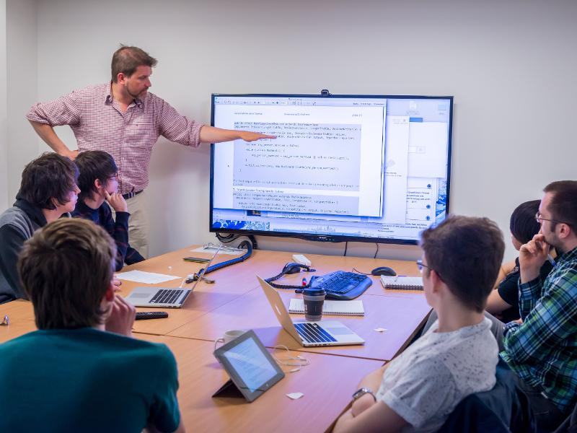
Computer studying at school
Notes:
Estonia teach computer programming to kids in grades 1 through 12. Estonian government provides computers to every classroom, so even kids from age 8 can make their own interactive games.

Slide 39
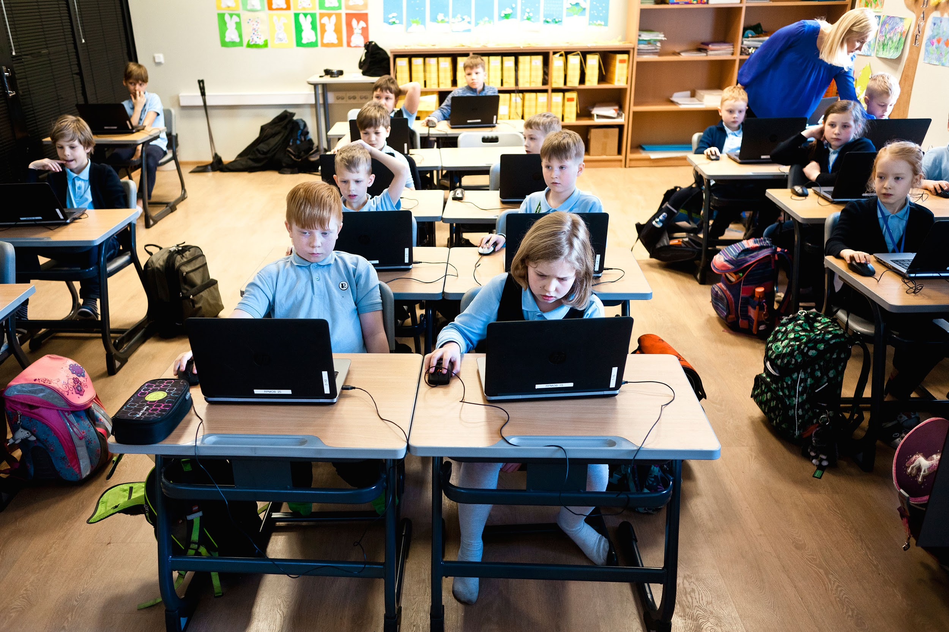

Slide 40
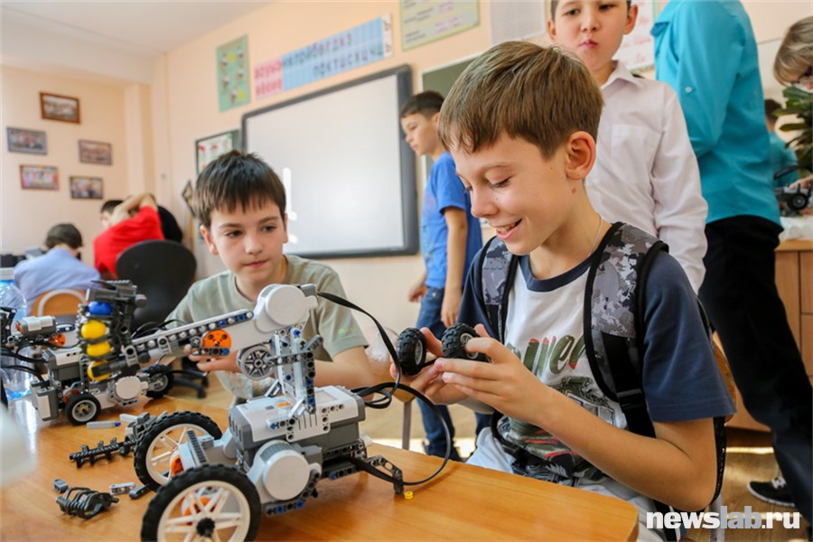

Slide 41
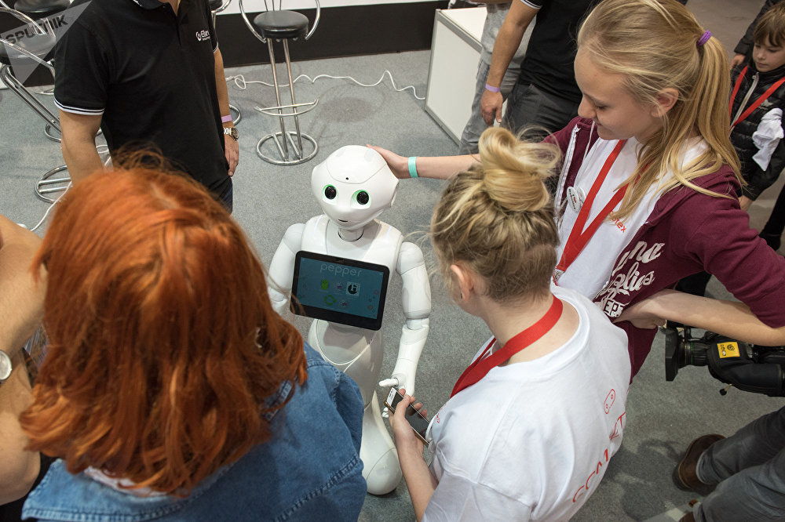

Slide 42
The invention of robots
Notes:
As a result... Estonian scientists invented robots that can deliver goods.
Estonian company Starship Technologies is building some revolutionary delivery robots which have already started cruising the sidewalks in Estonia, Britain and will soon the U.S.
Maybe someday you will also receive a parcel from me via Robot.

Slide 43
Estonian Chocolate Sweets

Slide 44
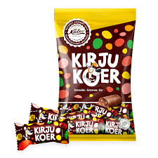

Slide 45
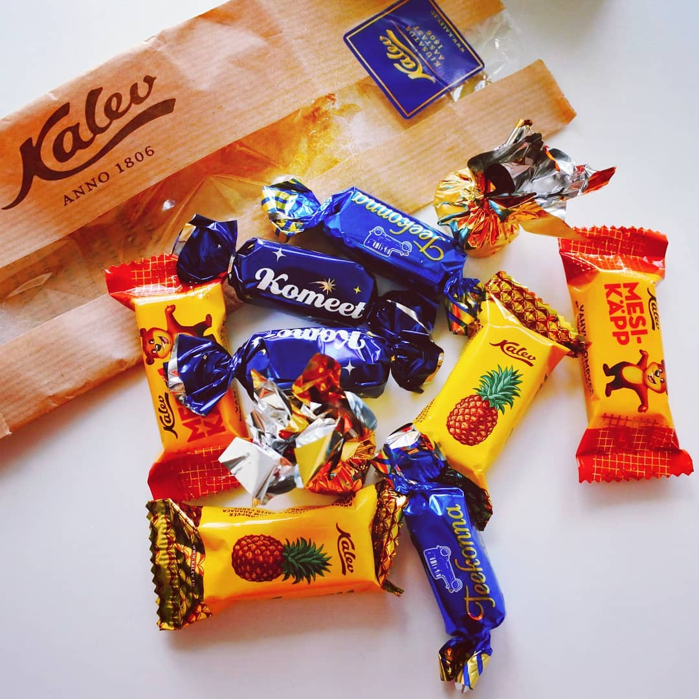

Slide 46
Thank you for watching!
Notes:
Although the weather in Estonia is often wet and rainy, we love to walk and spend time outdoors. You just need to have a pair of beautiful rubber boots and a raincoat.

